Slide 1

Vel Tech Rangarajan Dr. Sagunthala R&D Institute of Science and Technology
School of Computing
Department of Computer Science and Engineering
10211CS224 / FULL STACK APPLICATION DEVELOPMENT (JAVA)
PROJECT REVIEW : MILESTONE PROJECT – 1
Date: 24-03-2026
Real-Time Event Synchronization Engine
SDG: SDG 9 – Industry, Innovation and Infrastructure
Presented By:
G VARUN. VTU-26421
Courses Handling Faculty:
Dr. M.SUMITHRA

Slide 2
INTRODUCTION
This project, Real-Time Event Synchronizer Engine, is designed to overcome these limitations by enabling live event tracking and instant data synchronization. The system ensures that any change in an event is immediately reflected across all connected users without the need for manual refresh.
By leveraging real-time communication technologies like Socket.IO, the platform provides a responsive and efficient way to manage and monitor events. It enhances communication, reduces latency, and improves overall system reliability.
This solution is particularly useful in domains such as event management, logistics tracking, and live monitoring systems, where timely updates are critical for decision-making and operational efficiency.
Real-time systems remove delays. That directly improves decision-making, coordination, and user experience. In fast-moving environments, delayed data is basically wrong data.
1
2
3
4
5
6
7
8
9

Slide 3
PROBLEM STATEMENT
In many organizations and applications, event tracking is handled using traditional systems that lack real-time updates and efficient communication. Users are unable to monitor events instantly, and there is often a delay in receiving information. These systems also lack secure authentication and proper data management. This leads to inefficiency and poor user experience. Therefore, there is a need for a system that provides real-time tracking, secure user access, and instant updates to improve performance and reliability.
1
2
3
4
5
6
7
8
9

Slide 4
OBJECTIVES
To design and develop a real-time event tracking system using web technologies.
To implement secure user authentication using JWT and encrypted passwords.
To enable real-time communication using Socket.io.
To manage event data efficiently using a MySQL database
To build a web-based system that enables real-time tracking and synchronization of events across multiple users and platforms.
1
2
3
4
5
6
7
8
9

Slide 5
PROPOSED SYSTEM
The proposed system is a web-based Real-Time Event Synchronizer Engine that enables instant tracking and synchronization of events across multiple users. It uses Socket.IO to establish persistent connections between the server and clients, allowing real-time data exchange without repeated requests. Whenever an event is created, updated, or deleted, the server immediately broadcasts the changes to all connected users, ensuring consistency and eliminating delays. The system includes secure user authentication, a centralized database for event storage, and a dynamic dashboard for live monitoring. This approach improves communication efficiency, reduces latency, and provides a scalable solution for applications that require continuous and accurate real-time updates.
1
2
3
4
5
6
7
8
9

Slide 6
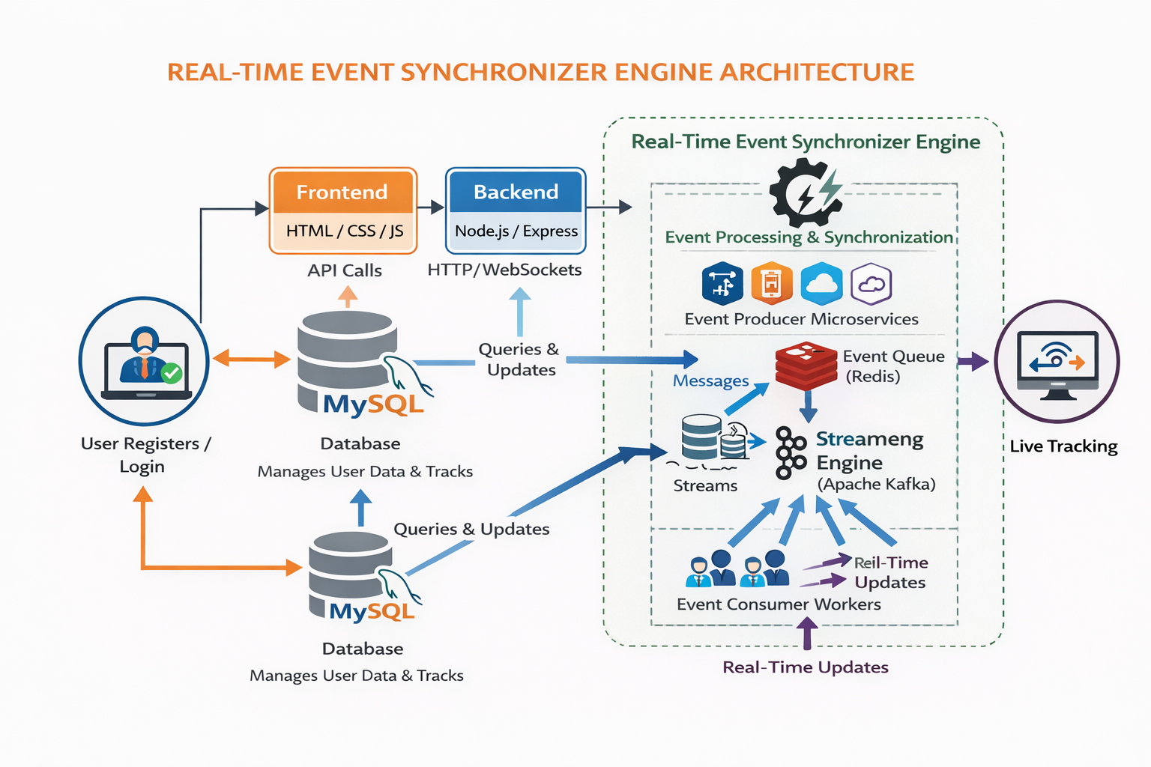
PROPOSED SYSTEM ARCHITECTURE
1
2
3
4
5
6
7
8
9

Slide 7
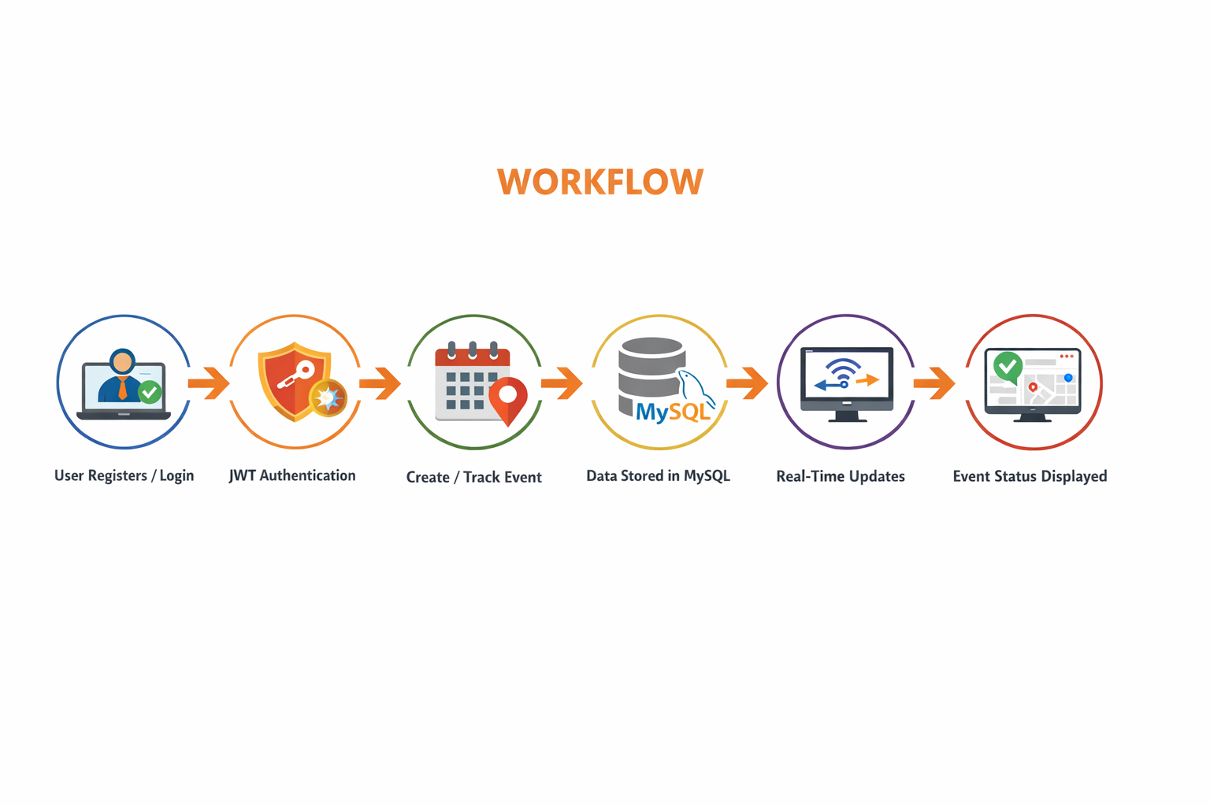
WORKFLOW
(Add dataflow diagram)
1
2
3
4
5
6
7
8
9

Slide 8
TECHNOLOGIES USED
1
Frontend:
1.HTML5
2.CSS3
3.Javascript
Backend:
1.Node.js.
2.Express.js
Database
:
1. MySQL
Tools:
1.VS Code
Software Requirements:
1.Windows / Mac
2. Web Browser
2
3
4
5
6
7
8
9

Slide 9
MODULE DESCRIPTION
Module 1: User Management
Handles user registration, login, and authentication using JWT and bcrypt.
Module 2: Event Management
Allows users to create, update, and manage events.
Module 3: Real-Time Tracking
Uses Socket.io to provide live updates of events.
Module 4: Database Management
Stores user and event data securely in MySQL.
1
2
3
4
5
6
7
8
9

Slide 10
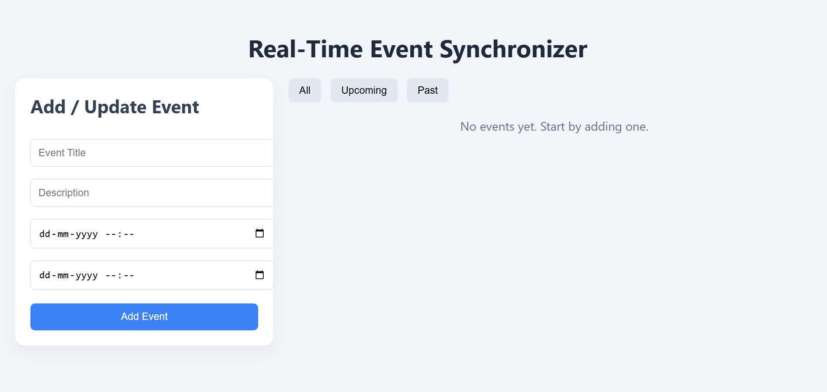
IMPLEMENTATION SCREENSHOTS
Main Page :
1
2
3
4
5
6
7
8(A)
9

Slide 11
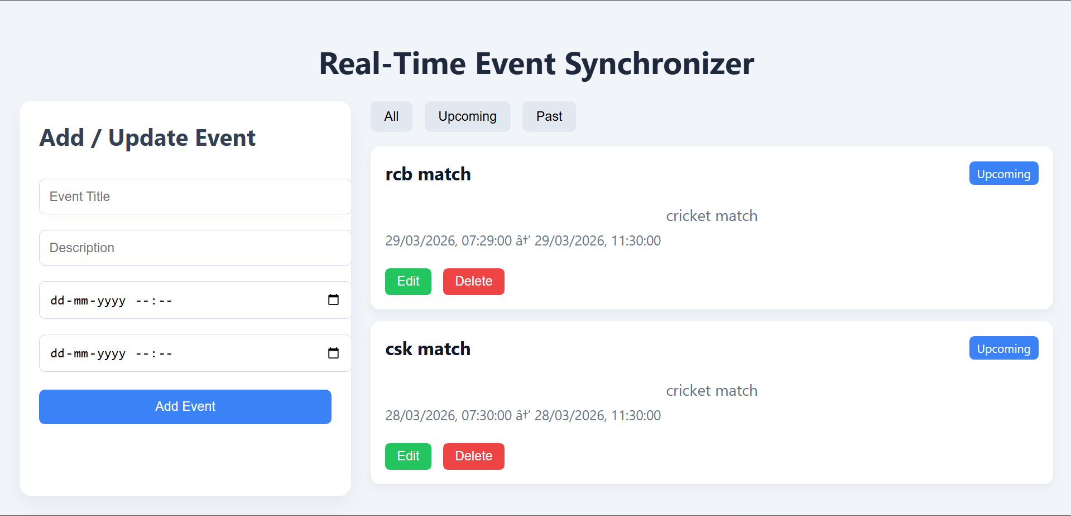
IMPLEMENTATION SCREENSHOTS
1
2
3
4
5
6
7
8(B)
9

Slide 12
ADVANTAGES & LIMITATIONS
Advantages:
Real-time updates
Secure authentication system
Fast and efficient
Scalable architectur.
Limitations:
Requires internet connection
Depends on server availability
Basic UI design
Can be improved with more features
1
2
3
4
5
6
7
8
9

Slide 13
Thank you

